Slide 1
Efficient Algorithms for Selected Problems: Design, Analysis and Implementation
Ye Myat Thein
Institute of Informatics
University of Bonn

Slide 2
Outline
Background Information
Overview of Algorithms
Implementation Aspect
Program Demonstration
Summary

Slide 3
Background Information

Slide 4
Flow Network
A directed graph in which each edge has a capacity to allow the flow of units from source node to destination node. Moreover, each edge has an associated cost to transport the units.
Minimum cost flow problem finds the cheapest possible way, without violation of capacity requirement, to find the transport of units across the graph so that all nodes are balanced.

Slide 5
Strongly Polynomial Algorithms
All of the algorithms to solve minimum cost flow problem fall into one of the two basic categories: weakly polynomial and strongly polynomial.
To be a strongly polynomial algorithms, two constrains must be met.
The number of arithmetic operations is polynomially bounded in the number of nodes n, and the number of arcs m.
The only arithmetic operations involved are comparisons, additions and subtraction.

Slide 6
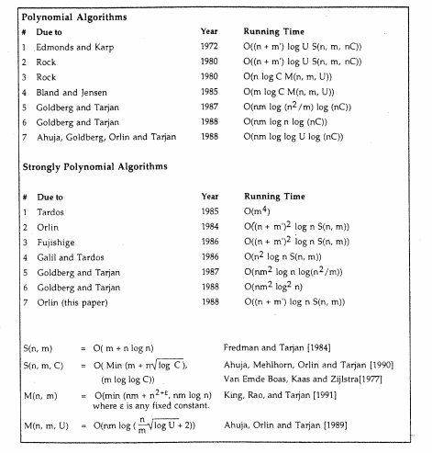
Running Time of Minimum Cost Flow Algorithms

Slide 7
Overview of Algorithms

Slide 8
Scaling Algorithms
Define a certain amount of units in each iteration for transport.
Well-known algorithms that use scaling to solve min-cost flow problems.
Successive shortest path and capacity scaling.
Cost scaling.

Slide 9
Edmonds-Karp Scaling Algorithm
Called Right Hand Side (RHS) scaling.
Use pseudoflows, node potential, reduced cost, and residual network concepts.
Find delta-optimality in each iteration.
The iterations terminate when delta less than 1 or all nodes in the graph are balanced.

Slide 10
Edmonds-Karp Scaling Algorithm
Initialization
delta<1 && has_imblance(g)
Find shortest paths and update node potentials
Augment delta units from selected source to dest
False
True
True
Update variables
!empty(Source_Set)
&&
!empty(Dest_Set)
Determine Source_Set and Destination_Set
False
Update delta
Print resulting graph

Slide 11
Orlin’s Strongly Polynomial Algorithm
Extension of RHS algorithm to become strongly polynomial.
Identify arcs whose flow are so large in the delta scaling phase that they are guaranteed to have positive flow in all subsequent scaling phases.
Sufficiently large amount is equal to 4*n*delta.
So any arc which has flows that is strictly greater than the threshold will be contracted.

Slide 12
Why 4*n*delta
In modified version of RHS algorithm, the flow in any arc can change at most 2*n*delta units.
The total number of phases can be 2*n.
The total change of flow is at most
2*n*(delta+delta/2+delta/4+…+1)=4*n*delta
The arcs which have flows that is strictly greater than the threshold are called strongly basic arcs and will be contracted.

Slide 13
Difference between Orlin’s Algorithm and RHS Algorithm
Initial delta selection.
Contraction before the determining the source set and target set.
Cost calculation must consider the contracted arcs by expanding them back at the end of the algorithm

Slide 14
Difference between Orlin’s Algorithm and RHS Algorithm
Initialization
delta<1 && has_imblance(g)
Find shortest paths and update node potentials
Augment delta units from selected source to dest
False
True
True
Update variables
!empty(Source_Set)
&&
!empty(Dest_Set)
Determine Source_Set and Destination_Set
False
Update delta
Print resulting graph

Slide 15
Illustration of Contraction
a
x
a
x
i
4*n*delta
j
v
b
y
b
y
b(v) = b(i) + b(j)
e(v) = e(i) + e(j)

Slide 16
Arcs Expansion and Cost Calculation
For example, let’s say we have the contracted node “abc” which is made up of two nodes: “ab” and “c”.
The node “ab” is the contraction between node “a” and node “b”.
When a contracted node is considered for expansion and cost calculation, two-steps-look-back approach is used.
So, to get the related cost of node “abc”, two contraction backward is looked back.

Slide 17
Arcs Expansion and Cost Calculation
abc
b
c
a

Slide 18
Implementation Aspect

Slide 19
Libraries and Programming Language
Python programming language due to its clear syntax and availability of scientific libraries.
NetworkX libray for basic infrasture such as graph, nodes, etc
Use Bellman Ford algorithm for finding shortest path, and this algorithm is provided by the NetworkX library.
Modular design, functions are separated logically and can be replaced easily.
Input module is well-separated from main programs so that new input graph can be specified easily.
Input is the graph data in text file and the output is the total cost of flows along with the flow information in each iteration. (displayed in the standard output)

Slide 20
Program Demonstration

Slide 21
Summary
Minimizing the cost of flow on network is a very useful problem in practical applications and there are many well-known algorithms to solve it.
Two types of algorithms are weakly polynomial and strongly polynomial.
In my work both types of algorithms are implemented (Edmonds-Karp and Orlin).
Assumptions are no negative weight and no limitation of capacity, and are made for simplicity in implementation.

Slide 22
Acknowledgement
I have used many related papers from Dr.James B. Orlin and learned the course “Network Optimization” from MIT open courseware to understand concepts and his algorithm.
This is the presentation for lab course at Institute of Informatics, University of Bonn offered by Prof.Dr.Norbert Blum and Mr.Matthias Kretschmer, and would like to thank them for support throughout the course.

